Slide 1


GNANAMANI COLLEGE OF TECHNOLOGY
Enhanced Security With Hostel Gate Pass Management System
GUINAMEDE :
Mr.M.S. SABARI,(AP/CSE)
Presented by:
RAJAN KUMAR MAHTO (620820104078)
AMAN KUMAR SINGH (620820104004)
ARVIND KUMAR SAH (620820104009)
RAMPRAVESH KUMAR YADAV (620820104081)
DATE: 10/05/2024

Slide 2
CONTENTS
ABSTRACT
INTRODUCTION
PURPOSE
FEATURES
ADVANTAGES
DISADVANTAGES
NEED THIS PROJECT
PROJECT DEMO

Slide 3

ABSTRACT
This project aims to use modern Technology and Easy Process through take Gate Pass.
This project aims to use modern Technology and Easy Process through take Gate Pass.
Digital gate passes generated by the system contain all necessary information, reducing the risk of errors or s compared to manually written passes.
Users can submit requests online, and staff can review and approve them digitally, saving time for both parties.
The system is easy to use and manage, as it will simplify the task and reduce the paper work.

Slide 4

INTRODUCTION
A Hostel Gate Pass Management System is a software solution designed to streamline the process.
The Hostel Gate Pass Management System is a digital platform designed to automate and optimize the gate passes for hostel residents.
Once a gate pass request is submitted, authorized person or hostel staff, as wardens or administrators, can give approve the request through the system.
A digital gate pass containing essential details such as the resident's name, date, destination, reason for leave.
There have a good advantages of the Hostel Gate Pass Management System, its ability to enhance security and control over hostel entry and exit.
Only authorized staff have access to approve and generate passes.

Slide 5
PURPOSE
The primary purpose of the system is to automate the process of Easily gate pass of hostel residents who need to leave the permission temporarily.
A digital platform for requesting and providing gate pass, the system eliminates the need for manual paperwork and face-to-face interactions, saving time for both residents and staff.
The system facilitates a streamlined approval workflow, allowing authorized hostel staff to review and approve gate pass requests efficiently.
Digitizing the gate pass issuance process enhances security by reducing the risk of unauthorized access or misuse of pass.

Slide 6

FEATURES
Users, including hostel residents and staff members, can register accounts on the system and authenticate then identities securely.
Hostel residents can submit gate pass requests through the system, specifying the reason for leave.
Authorized hostel staff, as wardens or administrators, can review and approve gate pass requests within the system, and approval depending on the hostel's policies.
The system maintains database of issued gate pass, including details of each pass such as the resident's name, date, and duration of leave

Slide 7
ADVANTAGES
Reduces Paper Work
Save Time
Secured data
Reduce the manual errors
Eliminate the tedious Work
Follow Rules
Maintains Records
Accountability

Slide 8

DISADVANTAGES
Technical Issues
Internet Access Issues
Resistance to change
Limited Accessibility
Cost of Implementation

Slide 9
NEED THIS PROJECT
Easily Access Gate Pass
Time Consumption
Record Keeping
Due to unavailability
Security
Manual Work difficult
Record Keeping

Slide 10


Slide 11
DEMO OF PROJECT..!

Slide 12
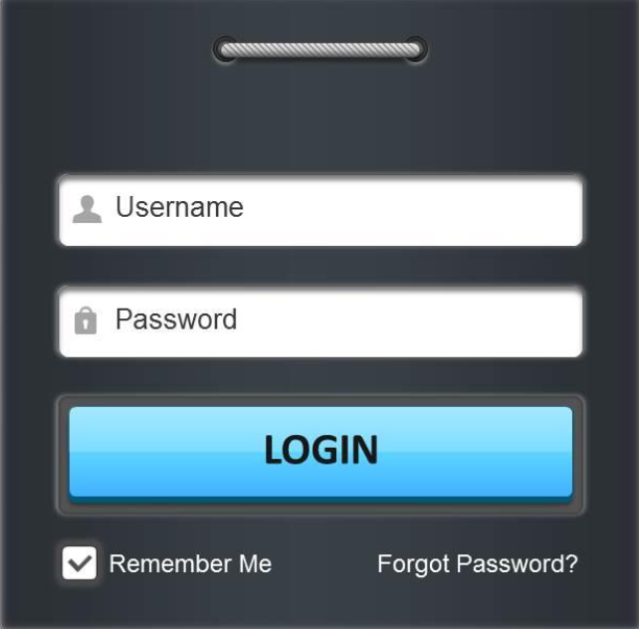
Student Login

Slide 13
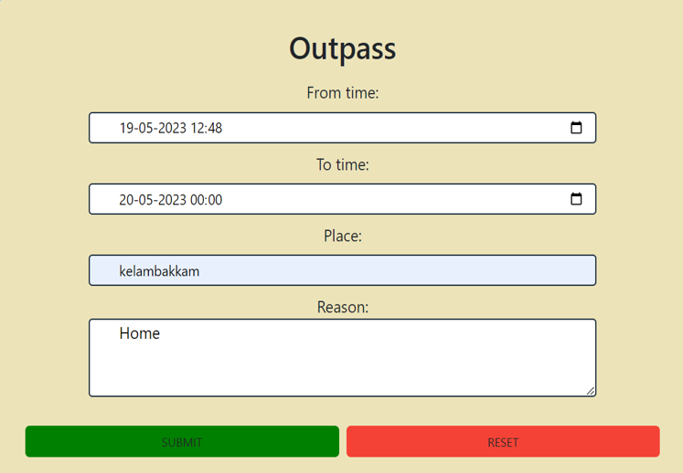
STUDENT REGISTRATION OUTPASS

Slide 14
WARDEN LOGIN

Slide 15
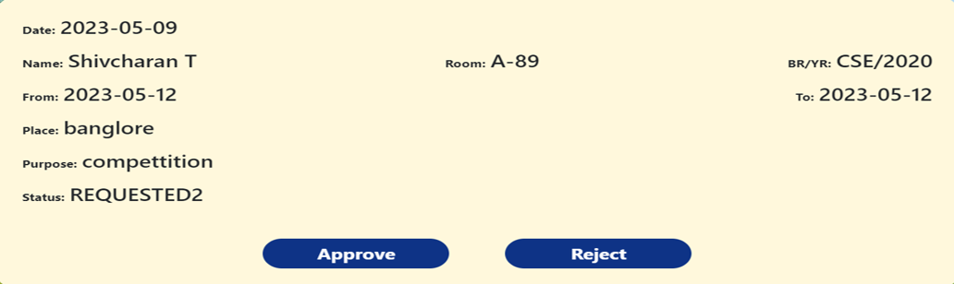
REQUEST FOR USERS

Slide 16
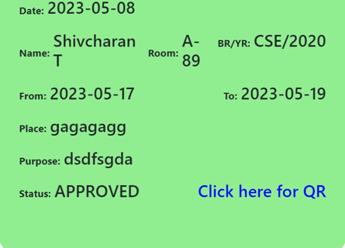
WARDEN PERMISSION

Slide 17
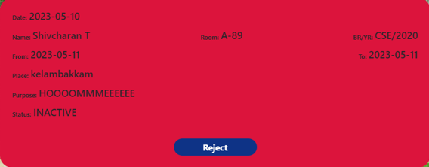
C
REJECTED STUDENT

Slide 18
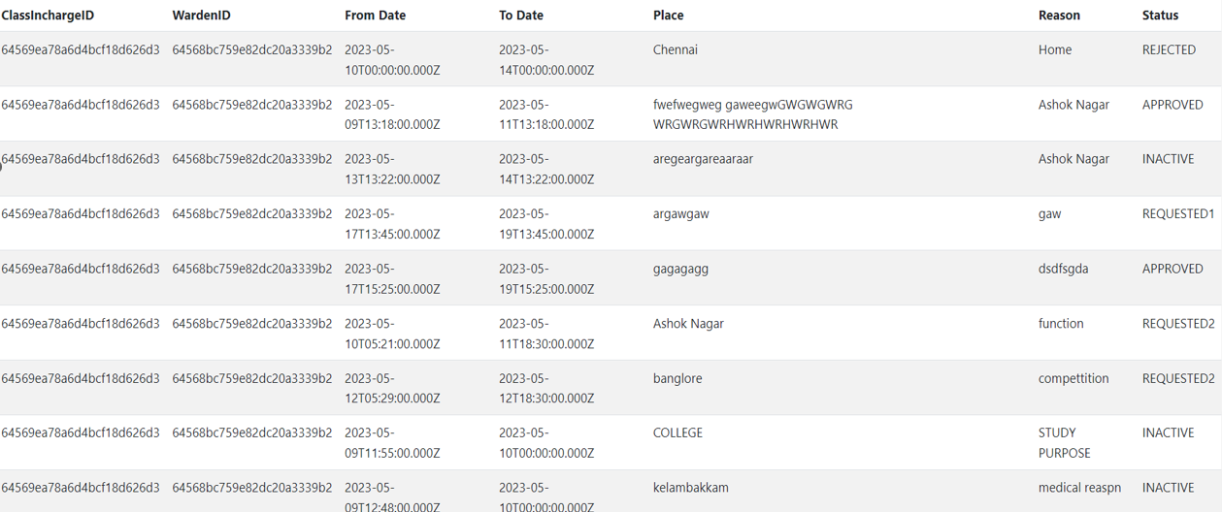
C
DATABASE HISTORY

Slide 19
C
GATE SECURITY

Slide 20
C

